Slide 1
https://docs.google.com/spreadsheets/d/1nh-lqdPshJ8ZdXtELRvZ0NJFEtk_e5y5CxAwCs6Bymw/edit?usp=sharing

Slide 2
https://docs.google.com/document/d/1uAoDONu_cTmicRbxmEaFt3b0HM0Vm3XEX4kR_ykOsKQ/edit?usp=sharing
THE PITCH

Slide 3
CoVmunity
An effort to restart the workplace

Slide 4
Opening
Description Mary

Slide 5
Problem
Total Cases - 8,893,946, Recovered Cases - 4,724,503
Total Deaths - 465,935
Worldwide economic losses estimated to cross $5.8-8.8 trillion
Notes:
Necesitamos fuentes de esta diapositiva.

Slide 6
Hospital discharge*
3rd level hospital*
Tests*
Viral load
Antibodies
Flow cytometry

Slide 7
Results*
Consultation*

Slide 8
SHE IS IMMUNE
WHAT DOES THIS MEAN?

Slide 9
HOW DID SHE ACCOMPLISHED IT?
Mock up with log in screen
Logo

Slide 10
Pathway
Patient
Self Registry*
Appointment
Testing
Doctor
Patient Registry
Patient Follow-up
Immunity assessment based on results
Responsible informed decision making

Slide 11
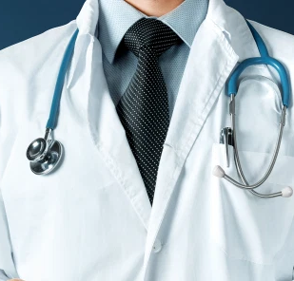
Pathway
Patient
Self Registry*
Appointment
Testing
1
2
Doctor
Patient Registry
Patient Follow-up
4
3
5
Immunity assessment based on results
Responsible informed decision making

Slide 12
Implementation
Facebook campaign
TV Ads
Hospital information modules

Slide 13
Multidisciplinary team
Goal
Closing

Slide 14
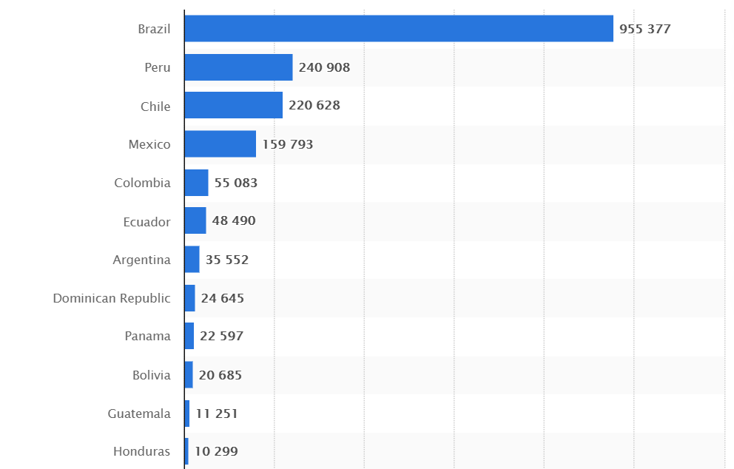
For Latin America
...and the numbers are only increasing exponentially by the day

Slide 15
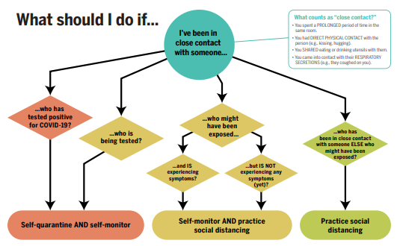
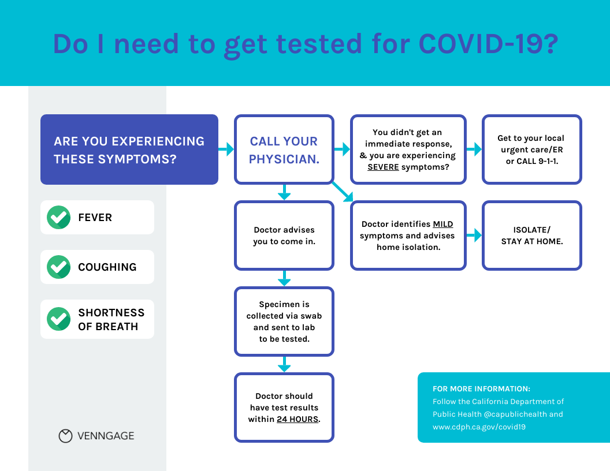
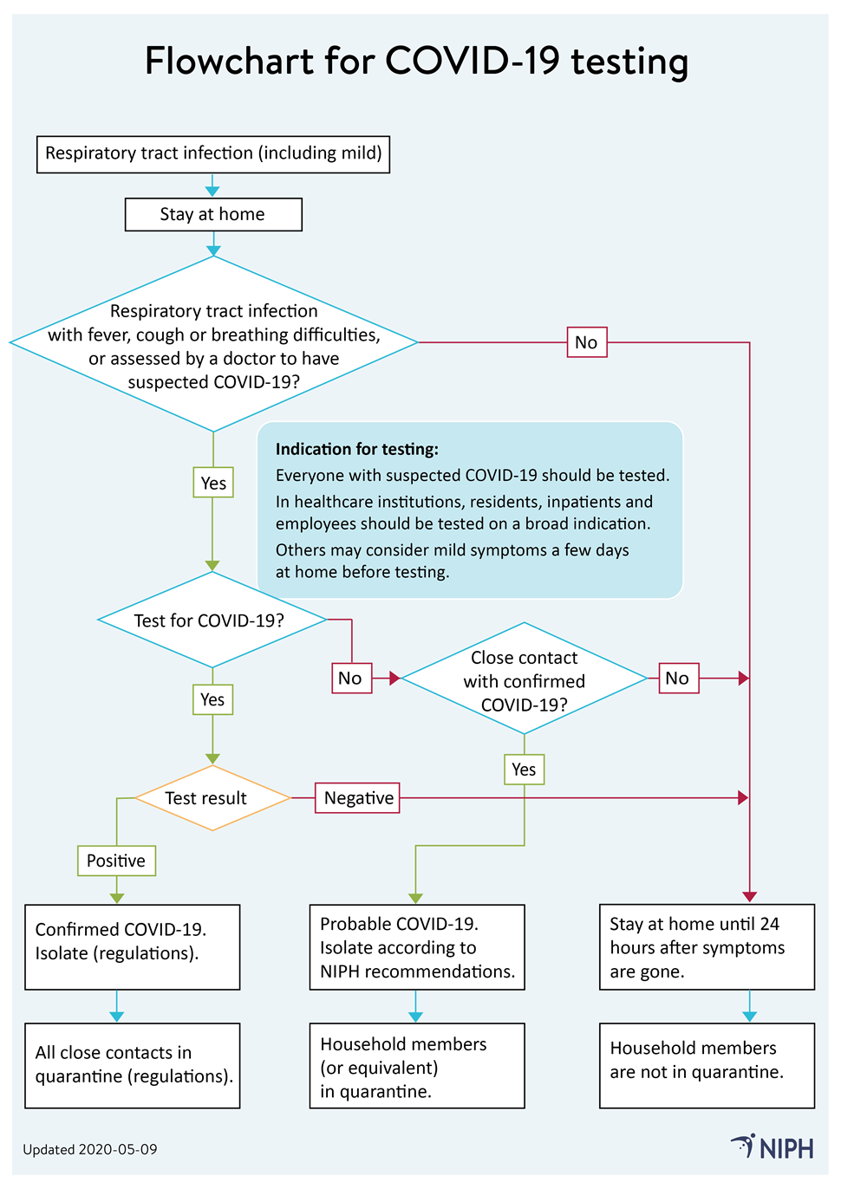
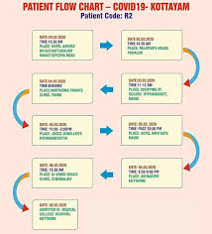
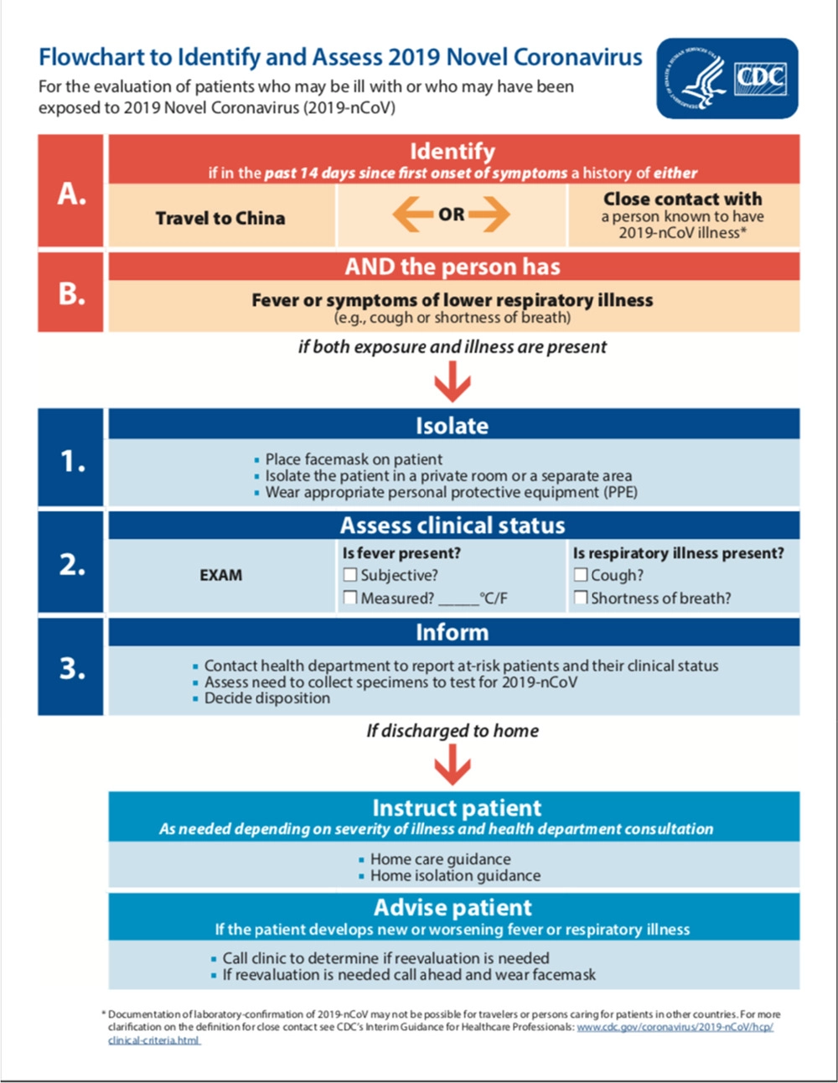
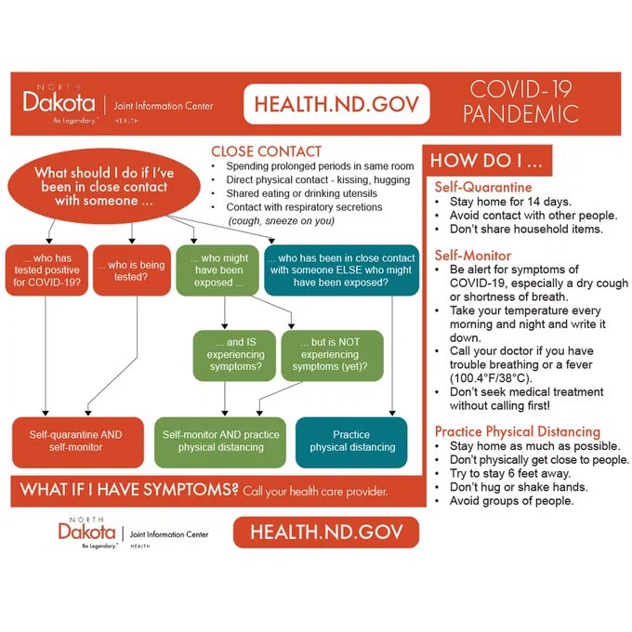
Why do we need this?
If you look at any flowchart made publicly available - protocol exists up till the time you get positive - and even till you get discharged - but nothing beyond that.
But why? You are not immune if you have had the coronavirus!

Slide 16
References

